Slide 1
KT Generator
Team Monster
Ravi Theja
Vibhav Agarwal
(MLE @ Glance/Inmobi)

Slide 2
Problem Statement
42% of knowledge is in minds, yet much is also embedded in code bases, often undocumented or overlooked.^{[1]}
Effective knowledge transfer in code ensures project continuity, aids in debugging, and sparks new innovations.
Often time-consuming, resource-intensive, and costly, particularly for legacy code bases.
Automation can streamline knowledge retrieval, transfer, and preservation processes.
[1] Norani, Nordin & Mohamed, Roshidah & Uchihira, Naoshi. (2019). Model of Tacit Knowledge Transfer in Lean Management Implementation in an Organization.

Slide 3
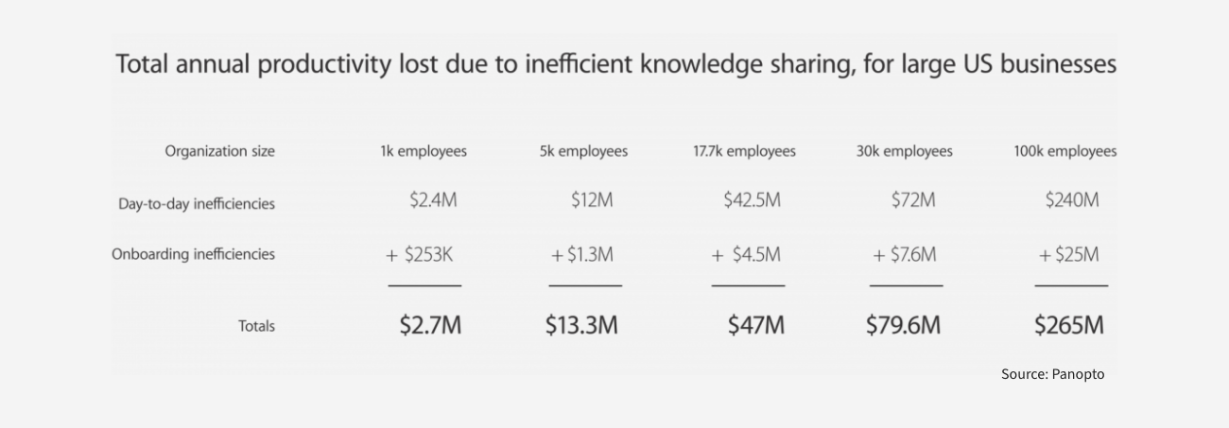
Current Issues
Productivity and monetary loss^{[2]}
Fragmented knowledge sources across teams and individuals
Hidden/lost knowledge for legacy or old code bases
[2] Inefficient Knowledge Sharing Costs Large Businesses $47 Million Per Year. https://www.panopto.com/about/news/inefficient-knowledge-sharing-costs-large-businesses-47-million-per-year/

Slide 4


Demo

Slide 5
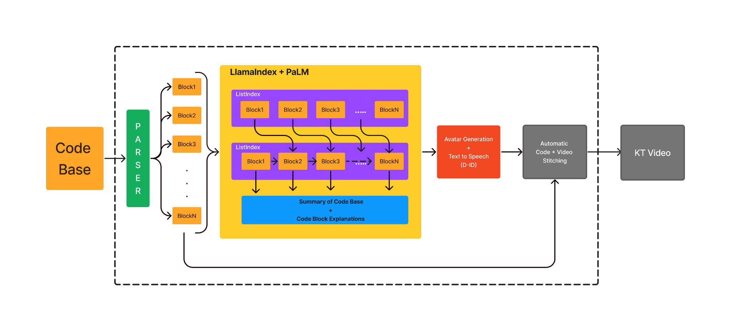
Solution/Architecture Overview

Slide 6
USP & Market Opportunity
Auto video creation for code explanation is novel and only text explanation existed until now
Extremely useful for both small/large organizations to save precious man hours and cost.
As mentioned previously, there’s a cost saving in the order of 250M+ for large organizations.
Our target audience is essentially IT folks like new hires for onboarding, people on notice period or just general developers/product people.

Slide 7
Future Plans
Generate videos for all code bases in large organizations to create video pools for internal usage (KodeTube).
Code base/KT video QA.
Add code update generation across commits for easy updates and cross region collaborations
Extend KT generation to have auto documentation.
Add more natural code transition and navigation.
Multilingual avatar generation and video creation.

Slide 8
Questions?

